Slide 1

Optimal Inventory Control Using Linear Programming
A Case Study with Real Sales and Inventory Data

Slide 2

Introduction
Objectives of the Analysis:
1. Analyze inventory levels compared to storage capacity.
2. Study demand trends versus order quantities.
3. Offer optimization insights for better inventory control.
Products Analyzed:
Apple Cider
Berry Juice
Mango Smoothie
Orange Soda

Slide 3

Problem Statement
Business Context:
Retailer managing inventory for Apple Cider, Berry Juice, Mango Smoothie and Orange Soda.
Dataset Source:
Kaggle’s “Sales and Inventory Dataset”.
Goal:
Determine the optimal order quantities that minimize costs for Apple Cider, Berry Juice, Mango Smoothie and Orange Soda
Metrics:
Monthly demand for Apple Cider, Berry Juice, Mango Smoothie and Orange Soda
Initial inventory, storage capacity, and associated costs

Slide 4
Methodology
Data Sources and Preprocessing:
Input data from Inventory.xlsx.
Optimization results integrated into the analysis.
Tools and Techniques Used:
1. CVXPY: For optimization tasks.
2. Pandas: For data cleaning and analysis.
3. Matplotlib: For creating visualizations.

Slide 5
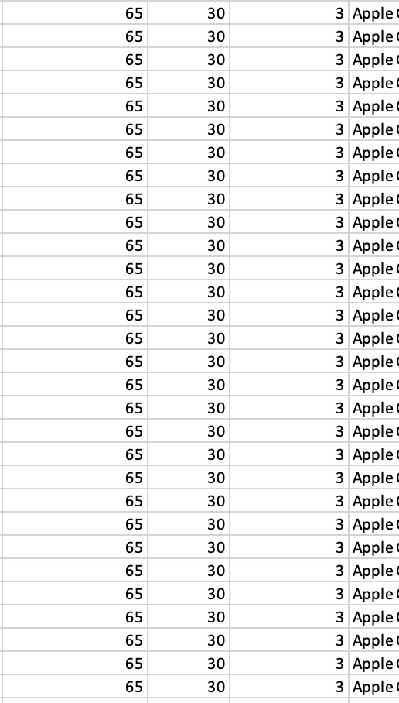
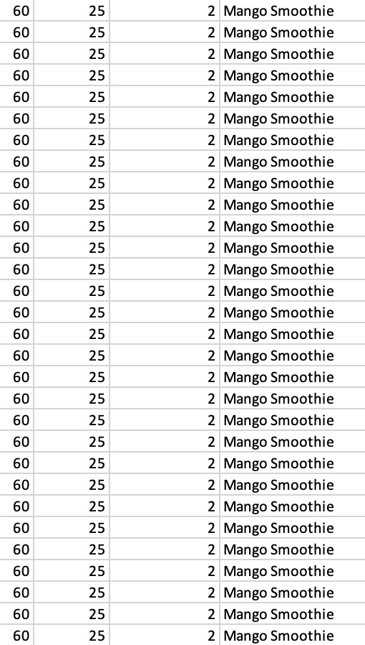
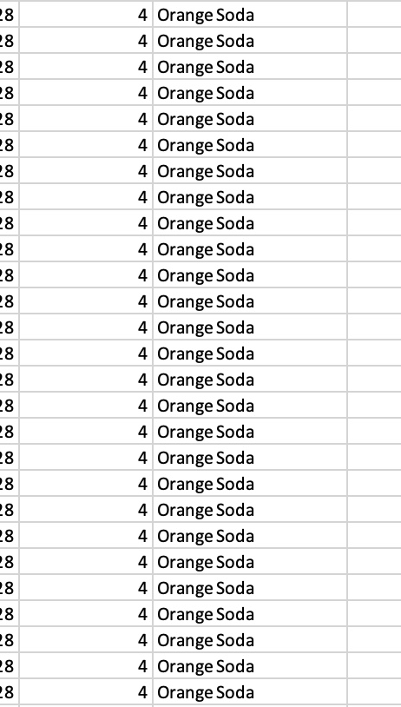
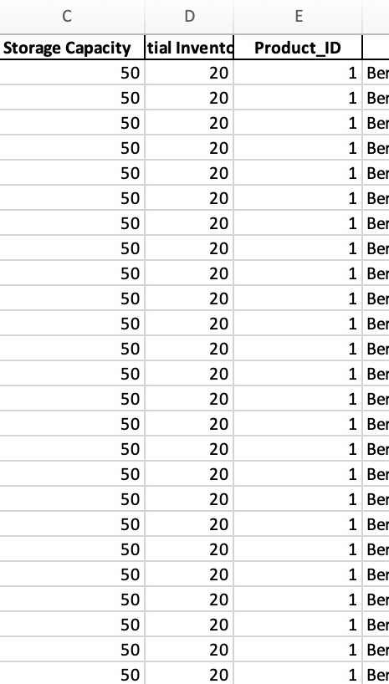
Dataset Overview

Slide 6
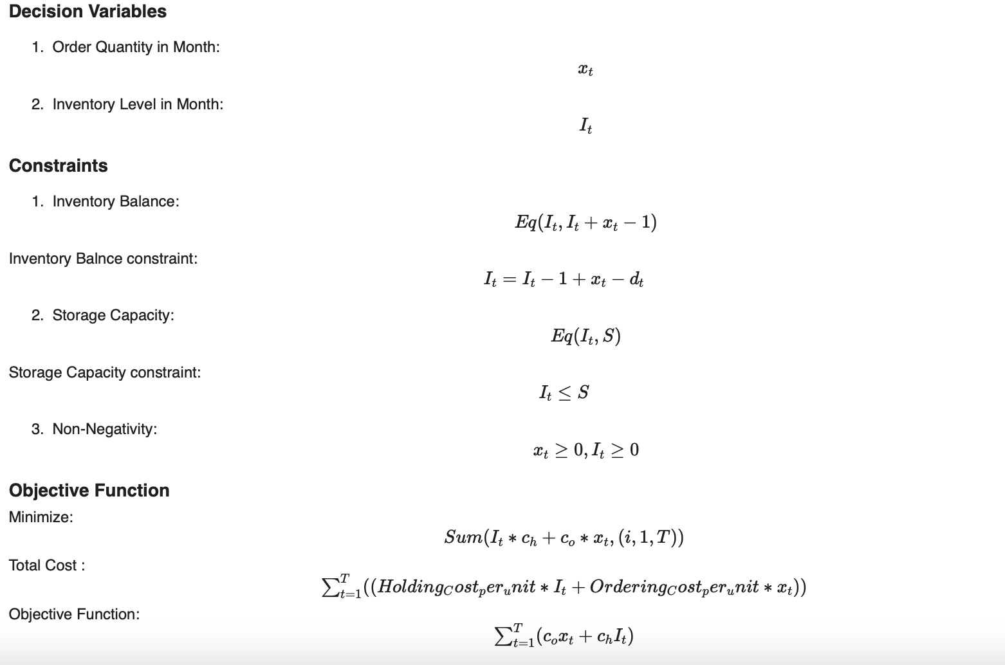
Mathematical Formulation

Slide 7
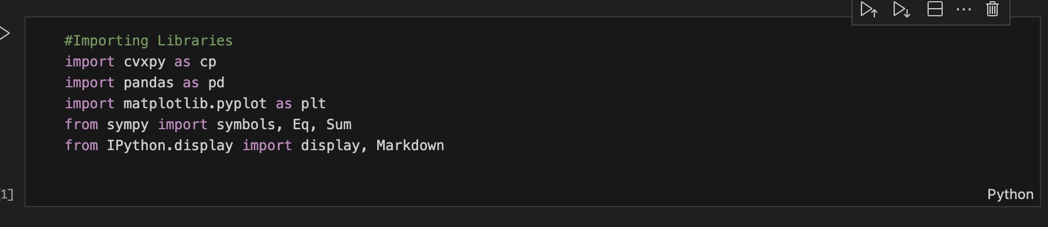
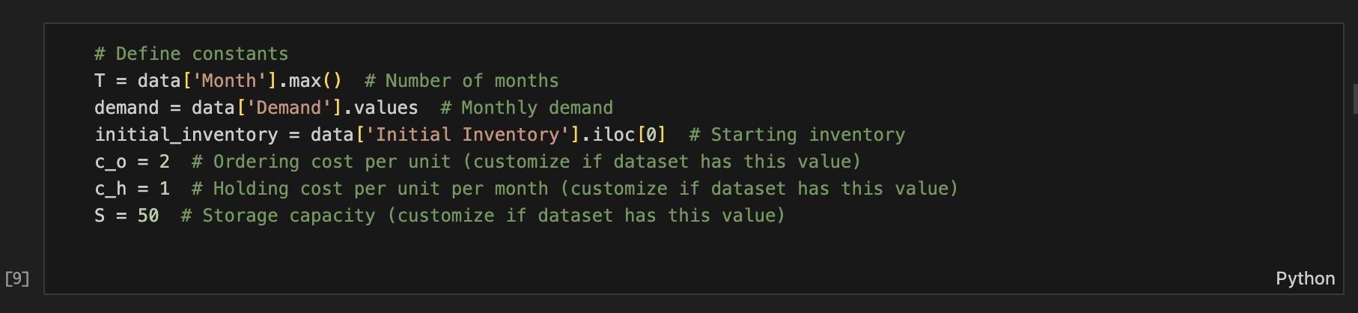
Python Implementation

Slide 8
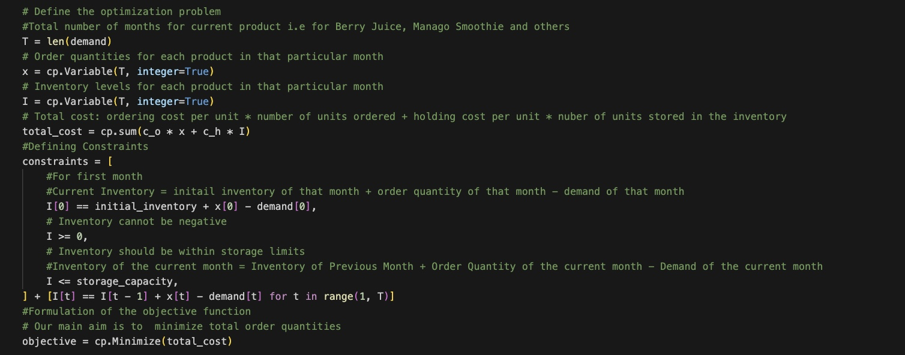
Python Implementation

Slide 9
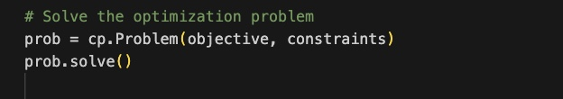
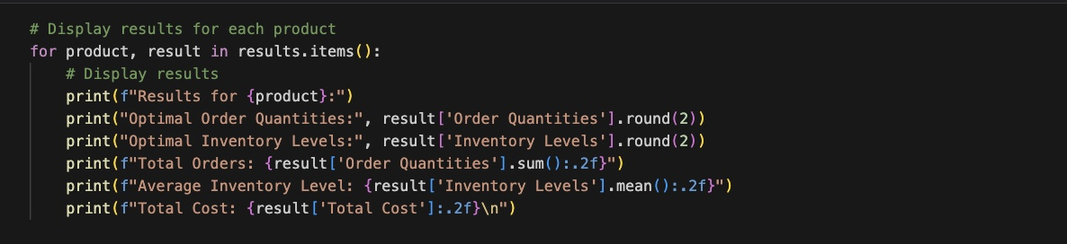
Python Implementation

Slide 10
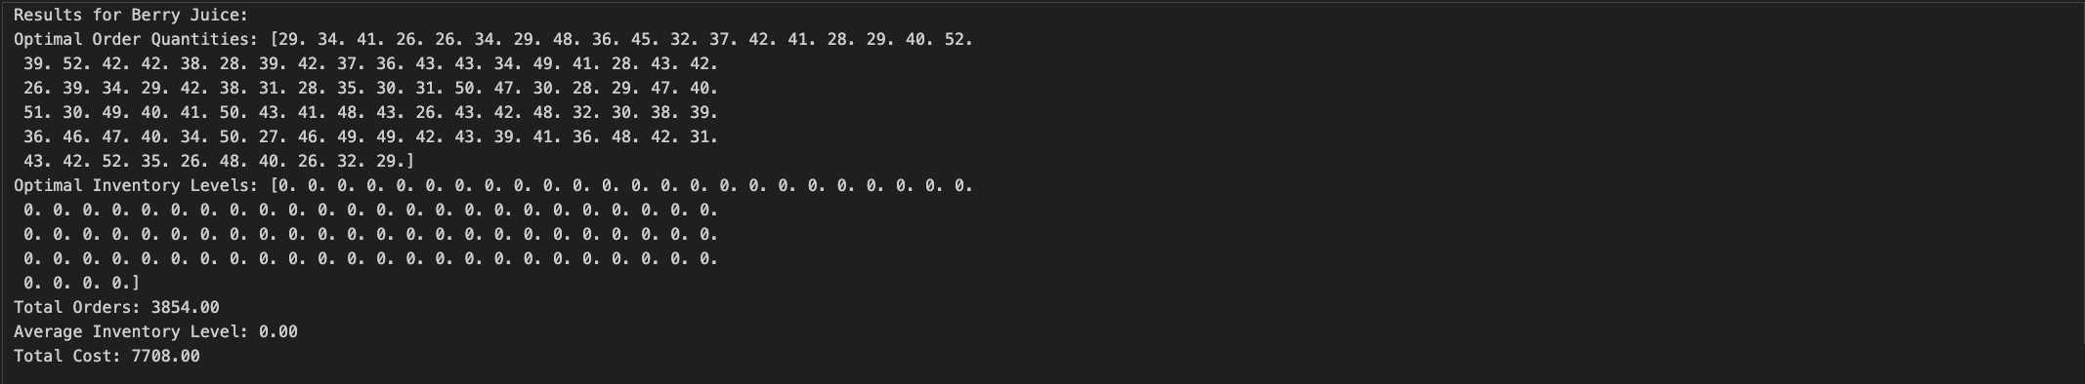
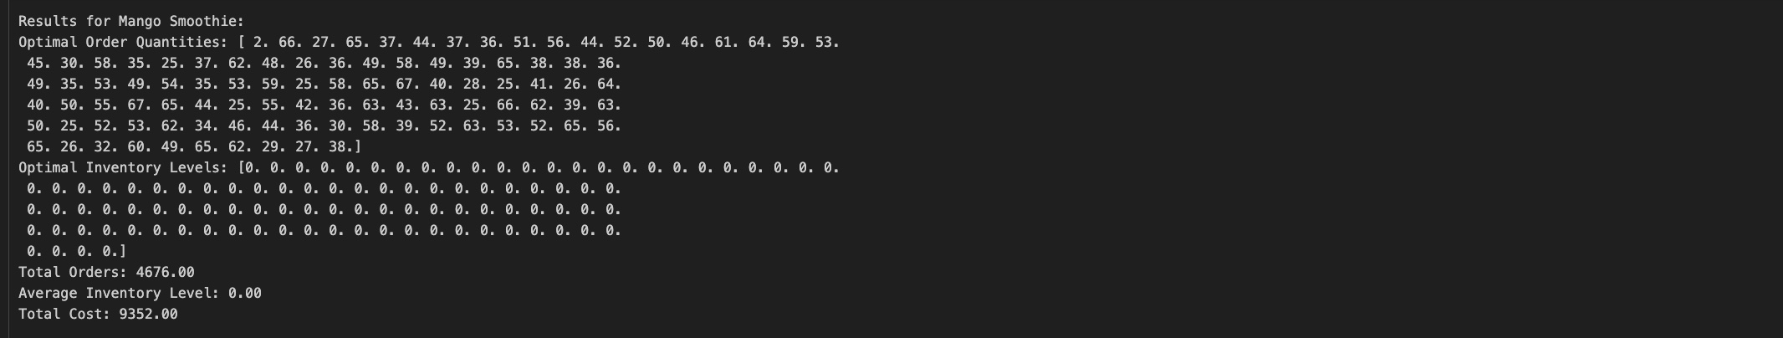
Output

Slide 11
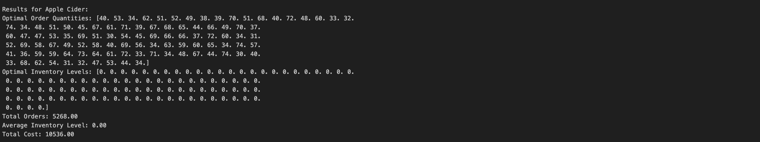
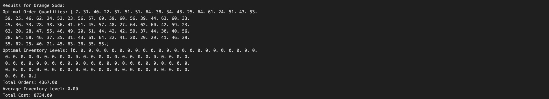
Output

Slide 12

Results
Outputs for All Products:
1. Optimal Order Quantities (xₜ): Precisely calculated monthly order quantities to meet demand and minimize costs.
2. Inventory Levels (Iₜ): Maintained inventory within storage capacity constraints throughout the year.
3. Cost Efficiency: Minimized total inventory management costs over the entire year.
Visualizations:
1. Monthly Demand vs. Order Quantities:
Compared monthly demand with calculated order quantities.
Highlighted alignment with demand requirements.
2. Inventory Trends:
Showed inventory levels over time.
Demonstrated adherence to storage limits and smooth fluctuations in stock.

Slide 13

Inferences
Cost Analysis:
Achieved significant reductions in ordering and holding costs for Apple Cider, Berry Juice, Mango Smoothie, and Orange Soda compared to traditional heuristic methods.
Efficiency Gains:
1. Met all monthly demand requirements for the analyzed products.
2. Maintained inventory levels within optimal limits.
3. Addressed demand variability effectively, ensuring smooth operations and consistent supply throughout the year.

Slide 14
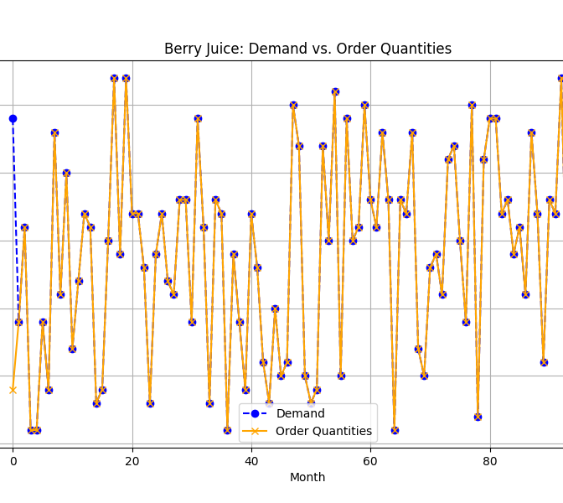
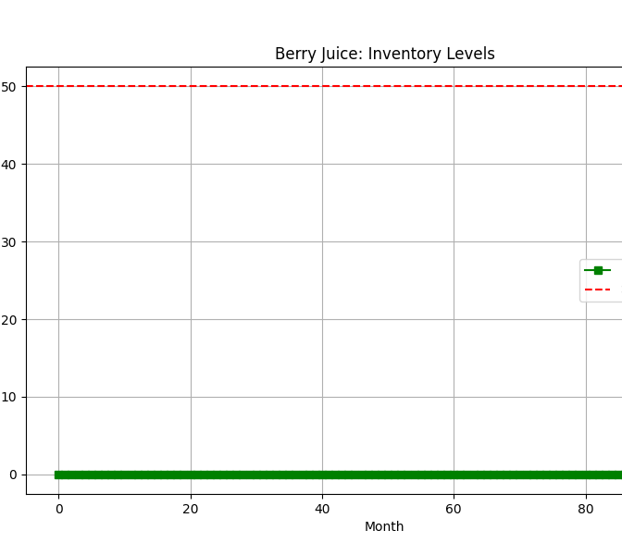
Berry Juice Insights

Slide 15
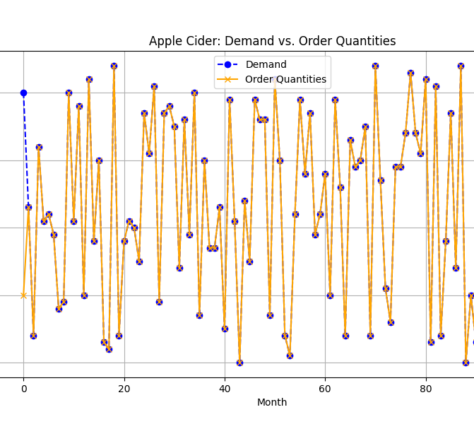
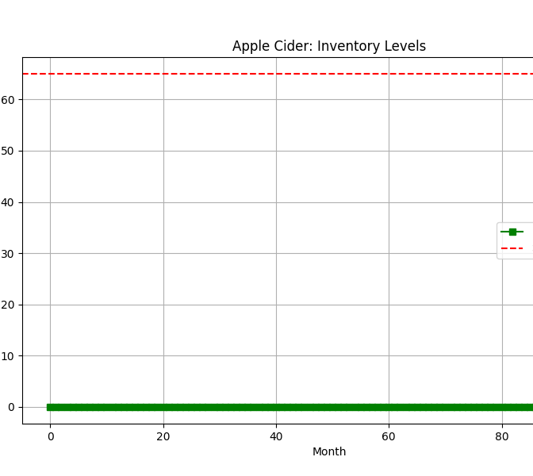
Apple Cider Insights

Slide 16
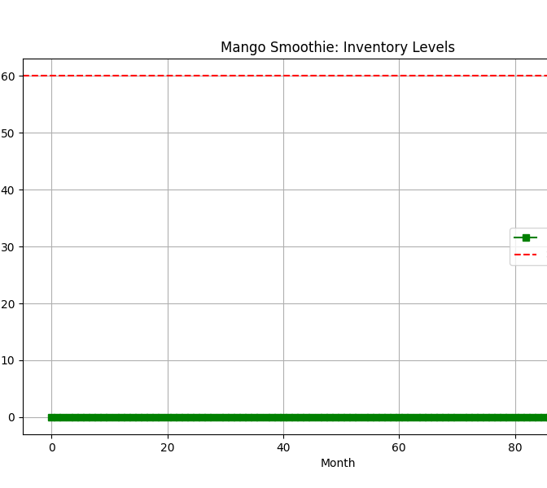
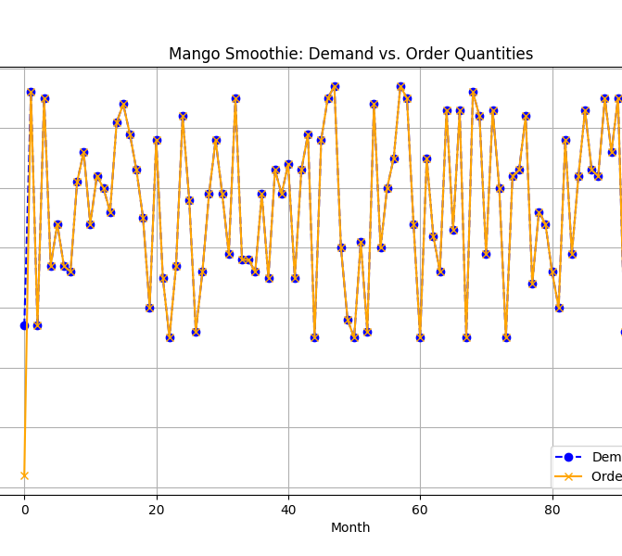
Mango Smoothie Insights

Slide 17
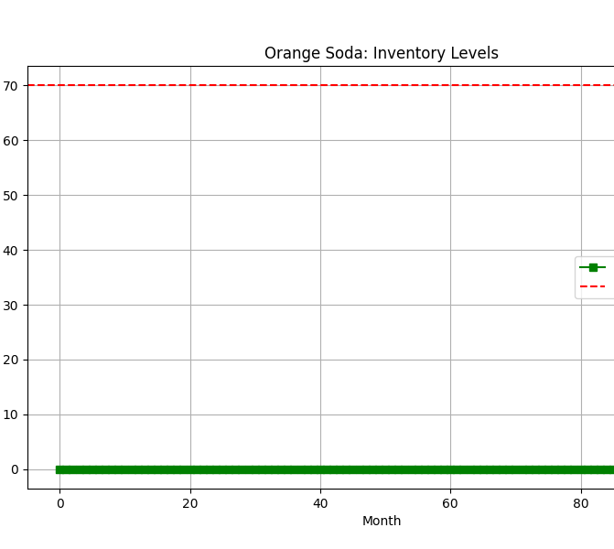
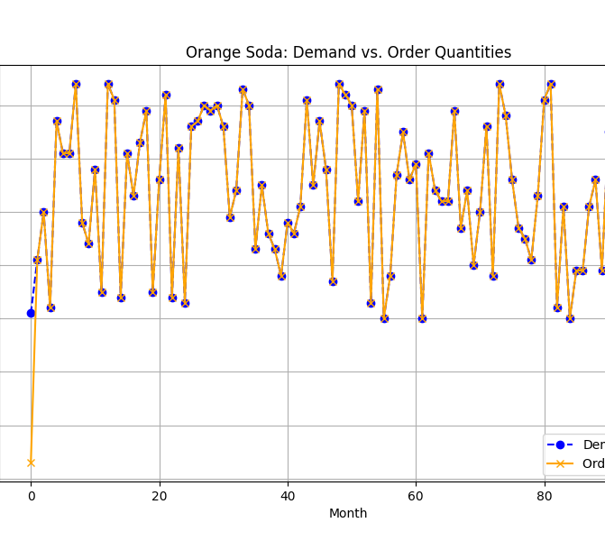
Orange Soda Insights

Slide 18
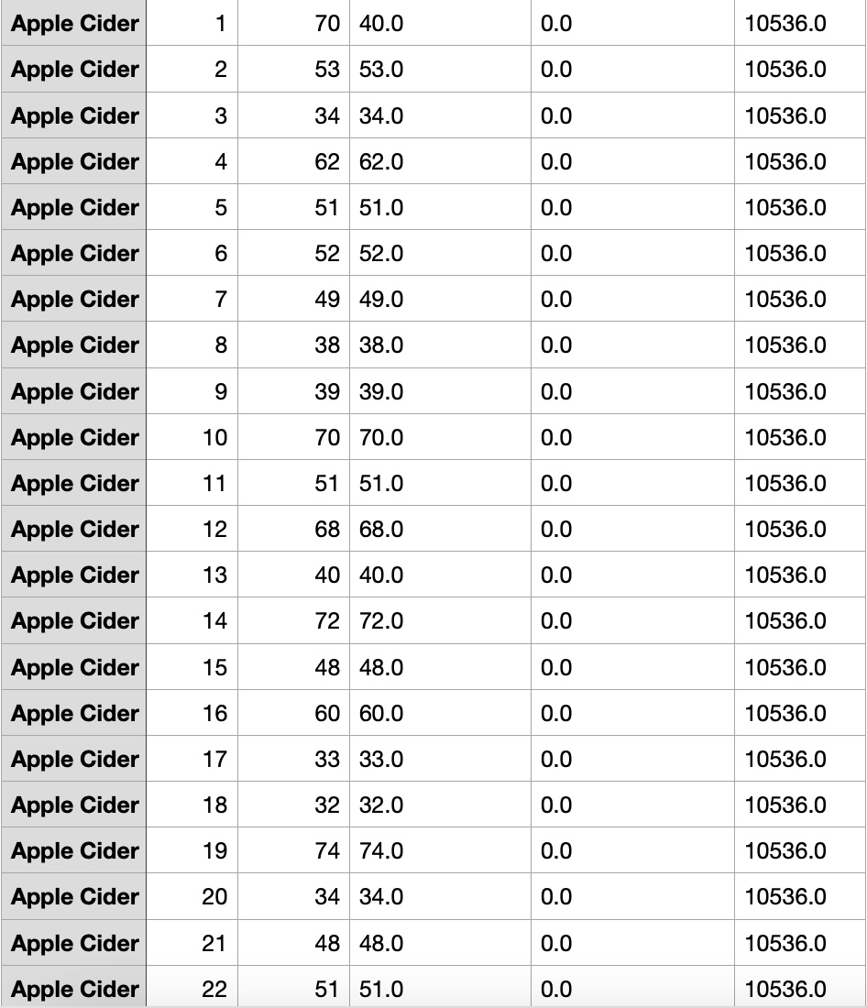
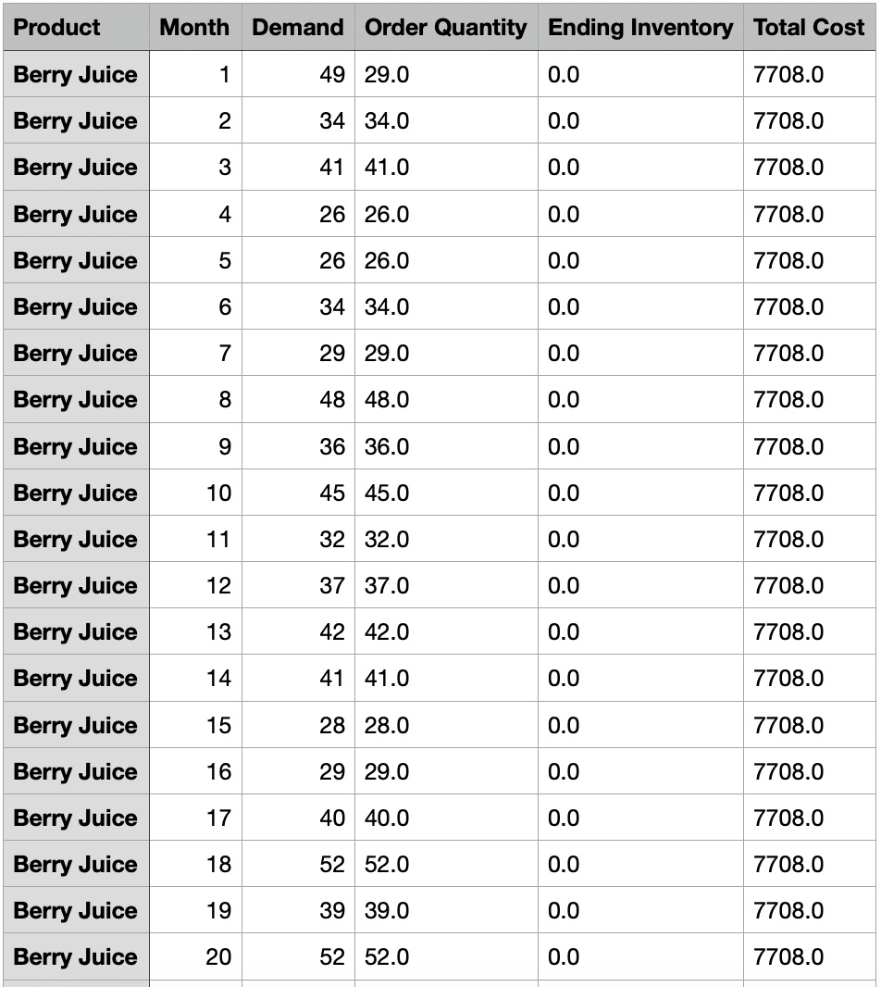
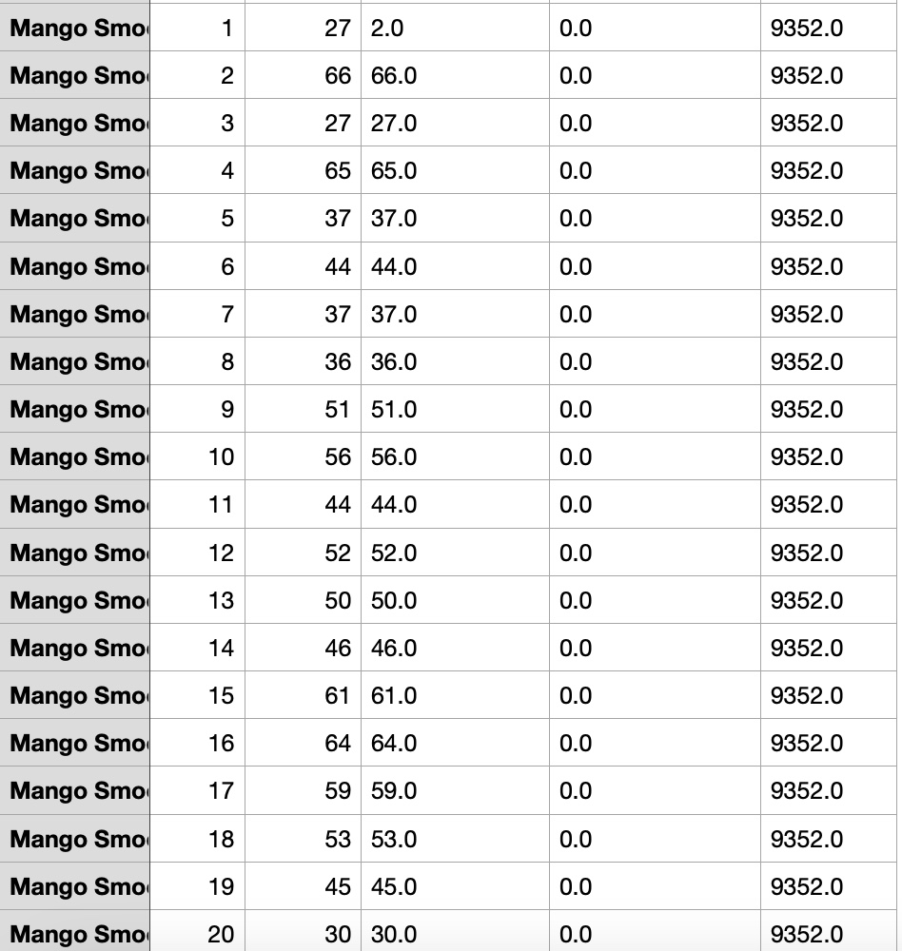
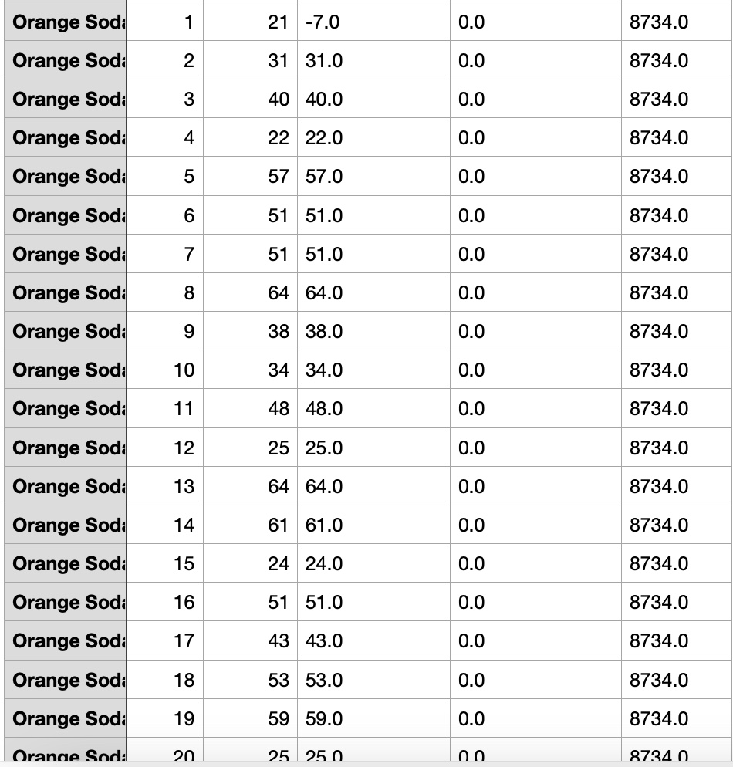
Insights

Slide 19

Conclusion
Effective inventory management balances demand and storage capacity.
Optimization insights help align orders with demand trends.
Implement recommendations to enhance efficiency and reduce costs.

Slide 20

References
Kaggle Sales and Inventory Dataset.
https://www.kaggle.com/datasets/yukisim/sales-and-inventory-dataset/data
Python Libraries: cvxpy, matplotlib, pandas.
Nayak, S. (2020). Fundamentals of Optimization Techniques with Algorithms. United Kingdom: Elsevier Science.
Taha, H. A. (2013). Operations research: An introduction (9th ed.). Pearson Education.
Kwon, C. (2019). Julia programming for operations research. Changhyun Kwon.

